Slide 1


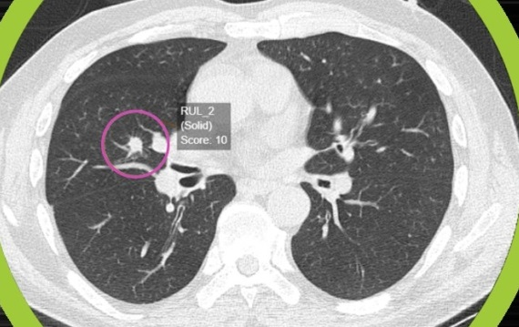
Group 6
Building a patient diagnosis system using the KNN algorithm.

Slide 2
Member List
Bùi Đức Anh
Ngô Văn Chung
Phạm Trung Hiếu
Nguyễn Văn Thành
Lưu Văn Linh

Slide 3

PRESENT THE TOPIC
CHAPTER I: BASIS THEORETICAL OF MACHINE LEARNING
CHAPTER II: OVERVIEW OF K-NEAREST NEIGHBOR (KNN) ALGORITHM
CHAPTER III: DESIGNING THE PATIENT'S DIAGNOSTIC SYSTEM USING KNN ALGORITHMS
I
II
III

Slide 4
Present The Topic
01
Reasons to choose the topic:
To contribute to the community and the country become healthier and prevent dangerous diseases.
02
Urgency and purpose of the topic:
9.6 million people died from lung cancer in 2018. Nowadays, about 84% of all deaths are related to lung cancer. It is difficult to diagnose lung cancer because it has symptoms in the late stages and it is almost impossible to save a person's life in the final stage.
03
Objects, contents, methods and research range:
General theory of identification techniques.
KNN algorithm.

Slide 5
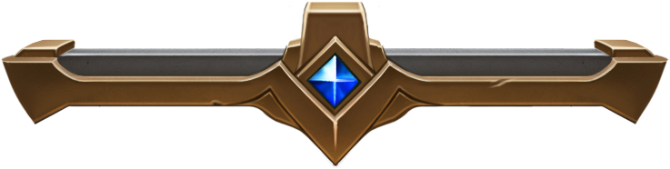


PROGRAMMING LANGUAGE AND INTERFACE
VISUAL STUDIO CODE
PYTHON

Slide 6
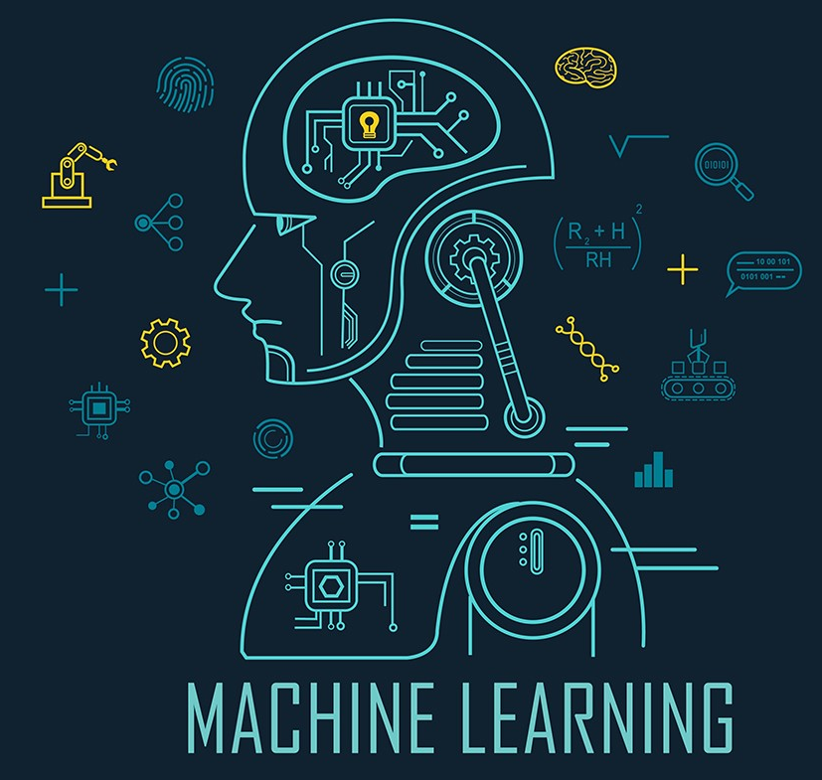
CHAPTER I: BASIS THEORETICAL OF MACHINE LEARNING

Slide 7
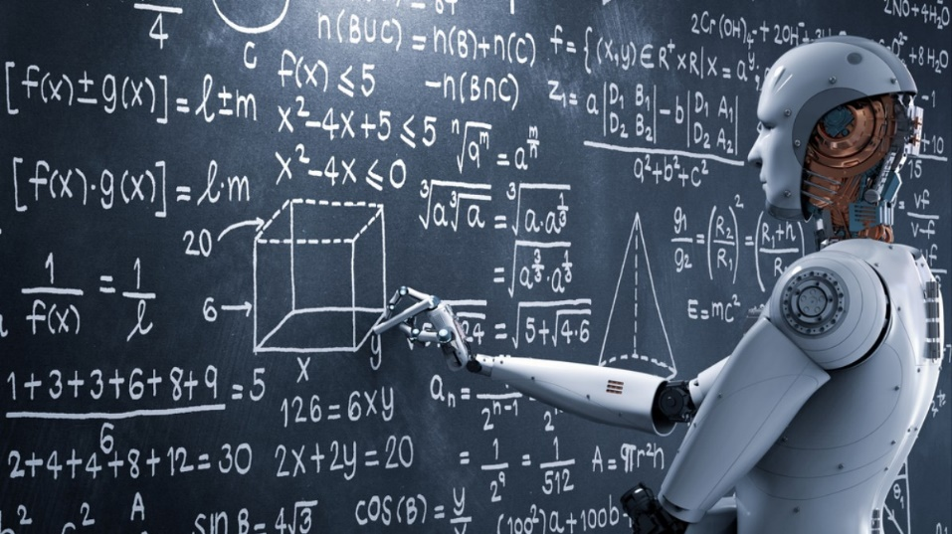
CHAPTER I: BASIS THEORETICAL OF MACHINE LEARNING
1.1: Synopsis of Machine Learning:
Machine learning is a subfield of artificial intelligence. Instead of relying on explicit programming, it is a system through which computers use a massive set of data and apply algorithms to "train" on--to teach themselves--and make predictions.

Slide 8
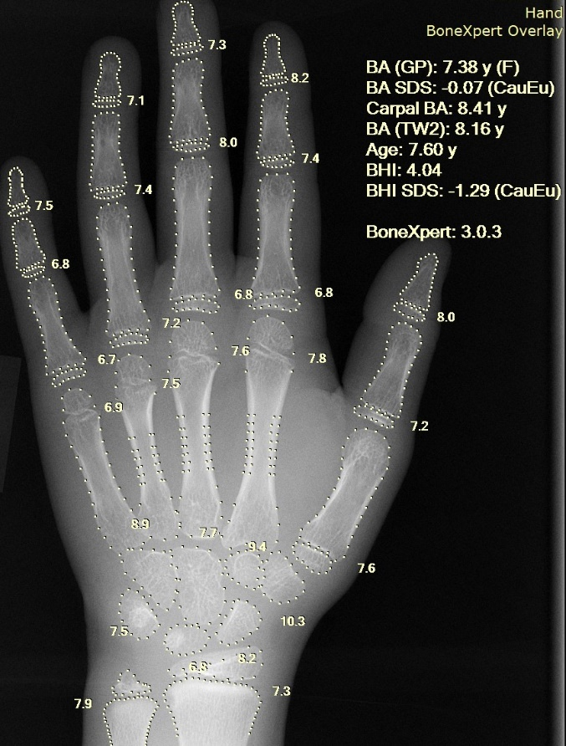
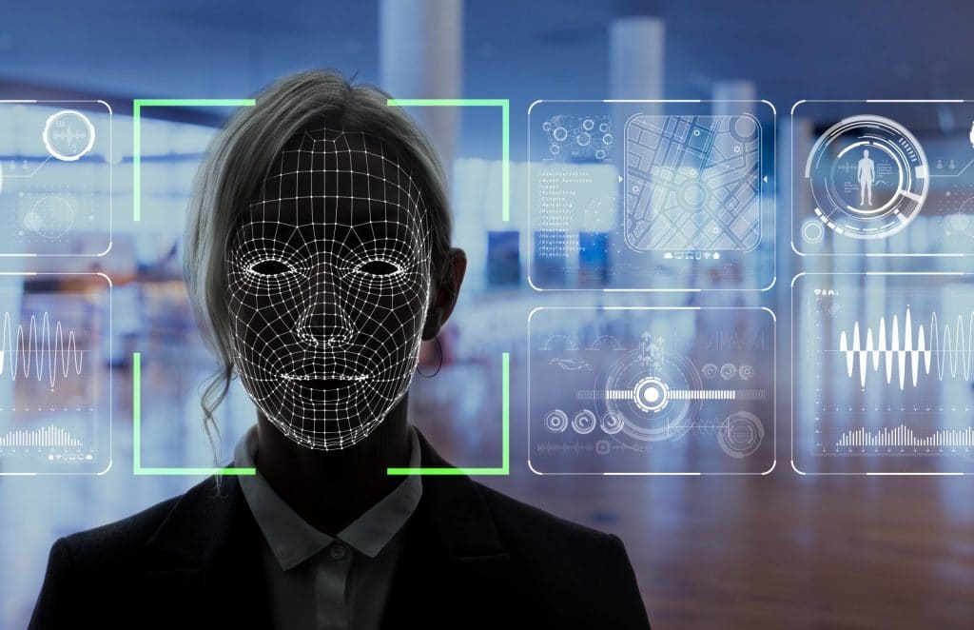
CHAPTER I: BASIS THEORETICAL OF MACHINE LEARNING
1.2: Machine Learning in reality:
Image recognition
Speech recognition
Medical diagnosis
ETC…

Slide 9
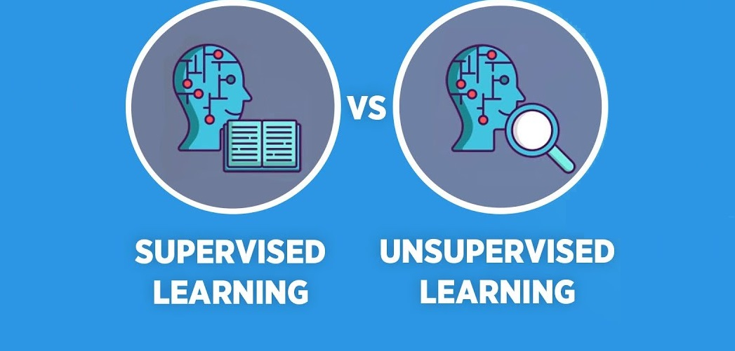
CHAPTER I: BASIS THEORETICAL OF MACHINE LEARNING
1.3: How Machine Learning works:
Machine learning uses two types of techniques: supervised learning, which trains a model on known input and output data so that it can predict future outputs, and unsupervised learning, which finds hidden patterns or intrinsic structures in input data.

Slide 10
CHAPTER I: BASIS THEORETICAL OF MACHINE LEARNING
1.4: Classification of Machine Learning Algorithms:
Grouping based on learning method
Function-based grouping
Supervised Learning
Unsupervised Learning

Slide 11
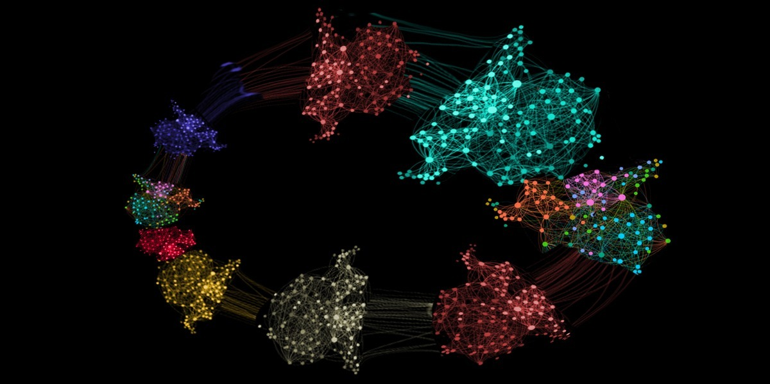
CHAPTER II: OVERVIEW OF K-NEAREST NEIGHBOR (KNN) ALGORITHM

Slide 12
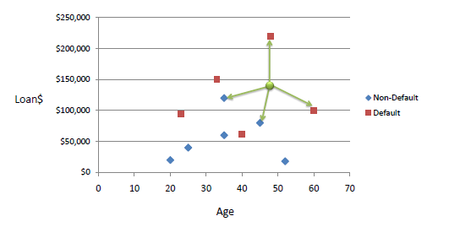
CHAPTER II: OVERVIEW OF K-NEAREST NEIGHBOR (KNN) ALGORITHM
2.1: Synopsis of K-Nearest Neighbor Algorithm:
One of the simplest Machine Learning algorithms based on Supervised Learning technique.
Assumes the similarity between the new case/data and available cases and put the new case into the category that is most similar to the available categories.
Stores all the available data and classifies a new data point based on the similarity.
Is a non-parametric algorithm.
Called a lazy learner algorithm.

Slide 13
CHAPTER II: OVERVIEW OF K-NEAREST NEIGHBOR (KNN) ALGORITHM
2.2: How does KNN work:
Step-1: Select the number K of the neighbors
Step-2: Calculate the Euclidean distance of K number of neighbors
Step-3: Take the K nearest neighbors as per the calculated Euclidean distance.
Step-4: Among these k neighbors, count the number of the data points in each category.
Step-5: Assign the new data points to that category for which the number of the neighbor is maximum.
Step-6: Our model is ready.

Slide 14
CHAPTER II: OVERVIEW OF K-NEAREST NEIGHBOR (KNN) ALGORITHM
2.3: Application of K-Nearest Neighbor:
Finding diabetics ratio
Recommendation System
Concept Search
Finding The Ratio of Breast Cancer

Slide 15

CHAPTER II: OVERVIEW OF K-NEAREST NEIGHBOR (KNN) ALGORITHM
NYM mới của NYC
Bố của NYC
NYC mới của NYC
Em của NYC
NYC

Slide 16
CHAPTER II: OVERVIEW OF K-NEAREST NEIGHBOR (KNN) ALGORITHM
2.4: Advantages and disadvantages of K-Nearest Neighbor:
Advantages of K-nearest Neighbor
It is simple to implement
It is robust to the noisy training data
It can be more effective if the training data is large
Disadvantages of K-nearest Neighbor
Always need to determine the value of K which may be complex some time
The computation cost is high because of calculating the distance between the data points for all the training samples

Slide 17

CHAPTER III: DESIGNING THE PATIENT'S DIAGNOSTIC SYSTEM USING KNN ALGORITHMS

Slide 18
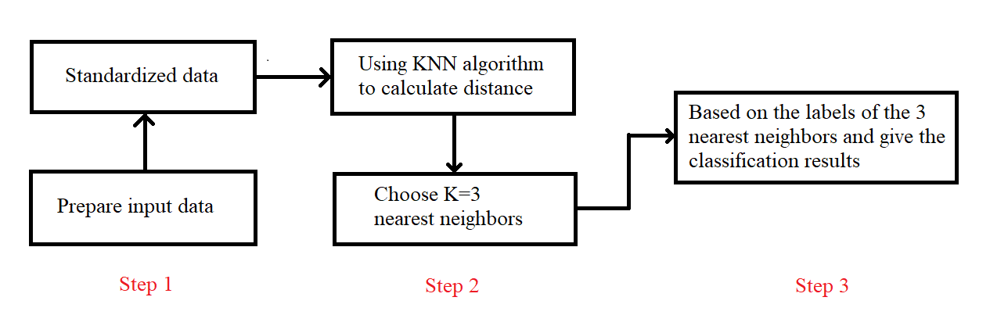
CHAPTER III: DESIGNING THE PATIENT'S DIAGNOSTIC SYSTEM USING KNN ALGORITHMS
3.1. General model of the system

Slide 19
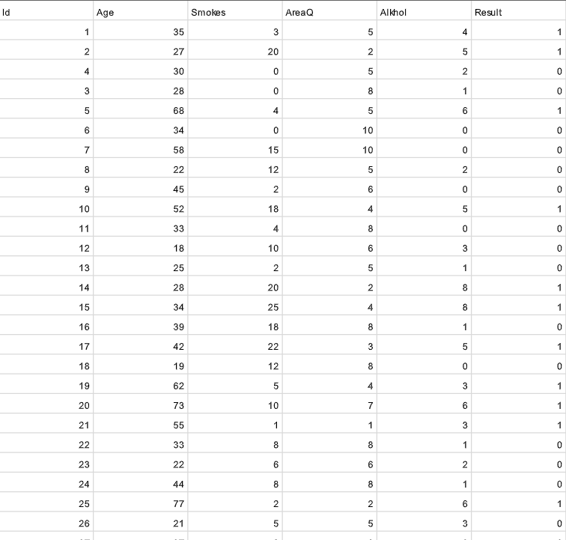
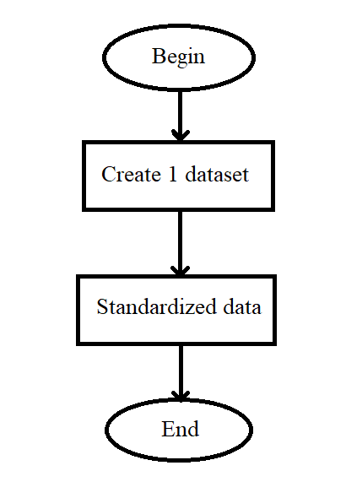
CHAPTER III: DESIGNING THE PATIENT'S DIAGNOSTIC SYSTEM USING KNN ALGORITHMS
3.2. Data preparation phase
At this stage we have created our own dataset of 150 diseases.

Slide 20
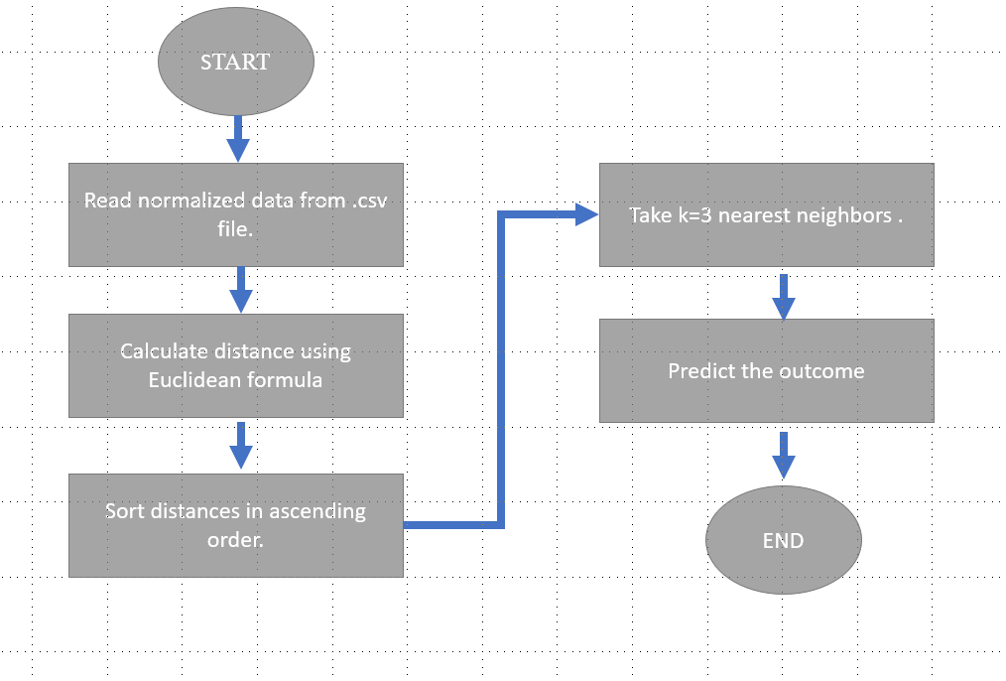
CHAPTER III: DESIGNING THE PATIENT'S DIAGNOSTIC SYSTEM USING KNN ALGORITHMS
3.3. Stage of building the problem on Python

Slide 21
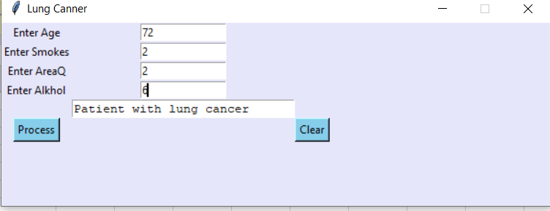
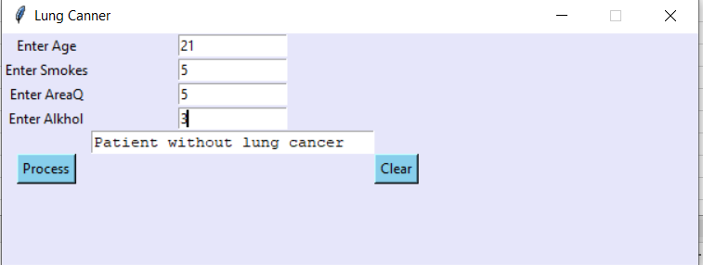
CHAPTER III: DESIGNING THE PATIENT'S DIAGNOSTIC SYSTEM USING KNN ALGORITHMS
3.4. Predicted results:
The patient with Age = 72, Smokes = 2, AreaQ = 2, Alkhol = 6 will have the result is “Patient with lung cancer”.
The patient with Age = 21, Smokes = 5, AreaQ = 5, Alkhol = 3 will have the result is “Patient without lung cancer”.

Slide 22
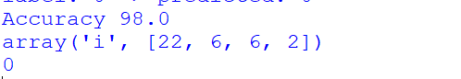
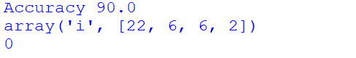
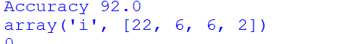
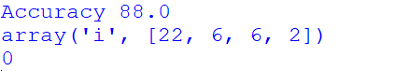
CHAPTER III: DESIGNING THE PATIENT'S DIAGNOSTIC SYSTEM USING KNN ALGORITHMS
3.4.2. Rate the accuracy:
With k=3, the calculated accuracy is 98%.
With k=5, the calculated accuracy is 92%.
With k=7, the calculated accuracy is 90%.
With k=9, the calculated accuracy is 88%.

Slide 23

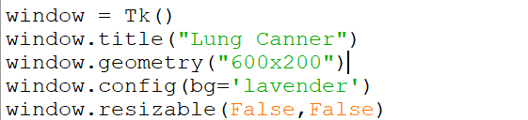
CHAPTER III: DESIGNING THE PATIENT'S DIAGNOSTIC SYSTEM USING KNN ALGORITHMS
3.5. Design application interface
Create the interface window:

Slide 24
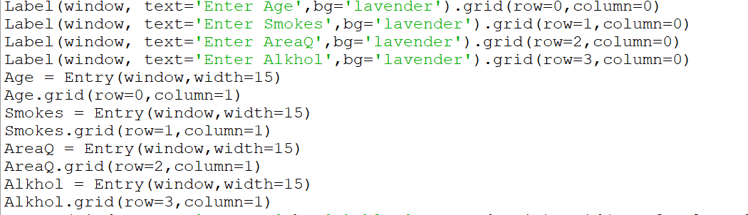
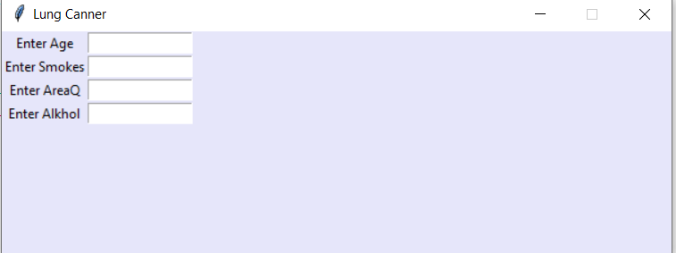
CHAPTER III: DESIGNING THE PATIENT'S DIAGNOSTIC SYSTEM USING KNN ALGORITHMS
3.5. Design application interface
Create Textboxes and Edit textboxes to import the input:

Slide 25
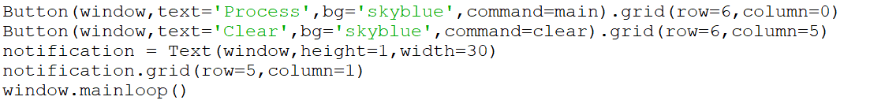
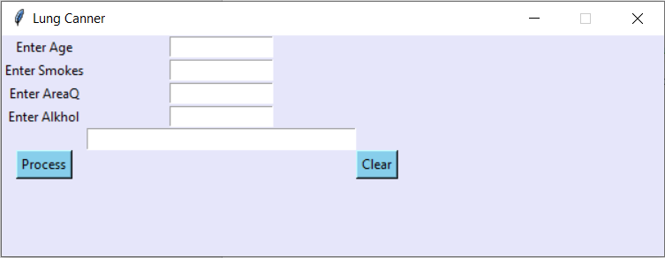
CHAPTER III: DESIGNING THE PATIENT'S DIAGNOSTIC SYSTEM USING KNN ALGORITHMS
3.5. Design application interface
Create buttons to show the result:

Slide 26
CHAPTER III: DESIGNING THE PATIENT'S DIAGNOSTIC SYSTEM USING KNN ALGORITHMS
3.5. Design application interface
The finished interface:

Slide 27
CONCLUSIONS AND DEVELOPMENT DIRECTIONS
3.5. Design application interface
Create the interface window:

Slide 28
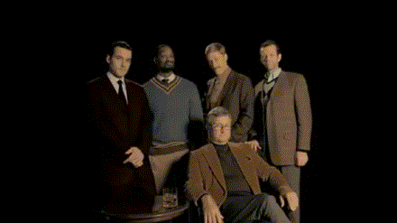
MISSION COMPLETED, CONGRATULATION !!!

